Slide 1

MOBILE Applications Using Android
ANDROID GRAPHICS AND STYLES

Slide 2

ANDROID GRAPHICS AND STYLING
Creating and using styles
Creating and using themes
Creating Icons
Creating nine NinePatch drawables

Slide 3
ANDROID -CREATING AND USING STYLES
A style resource defines the format and look for a UI. A style can be applied to an individual View (from within a layout file) or to an entire Activity or application (from within the manifest file).
A style is defined in an XML resource that is separate from the XML that specifies the layout. This XML file resides under res/values/ directory of your project and will have <resources> as the root node which is mandatory for the style file. The name of the XML file is arbitrary, but it must use the .xml extension.
You can define multiple styles per file using <style> tag but each style will have its name that uniquely identifies the style. Android style attributes are set using <item> tag as shown below

Slide 4
ANDROID –XML for STYLE
<?xml version="1.0" encoding="utf-8"?>
<resources>
<style name="CustomFontStyle">
<item name="android:layout_width">fill_parent</item>
<item name="android:layout_height">wrap_content</item>
<item name="android:capitalize">characters</item>
<item name="android:typeface">monospace</item>
<item name="android:textSize">12pt</item>
<item name="android:textColor">#00FF00</item>/>
</style>
</resources>
The value for the <item> can be a keyword string, a hex color, a reference to another
resource type, or other value depending on the style property

Slide 5
ANDROID –USING STYLE
Once your style is defined, you can use it in your XML Layout file using style attribute as follows −
<?xml version="1.0" encoding="utf-8"?>
<LinearLayout xmlns:android="http://schemas.android.com/apk/res/android" android:layout_width="fill_parent"
android:layout_height="fill_parent"
android:orientation="vertical" >
<TextView android:id="@+id/text_id"
style="@style/CustomFontStyle"
android:text="@string/hello_world" />
</LinearLayout>

Slide 6
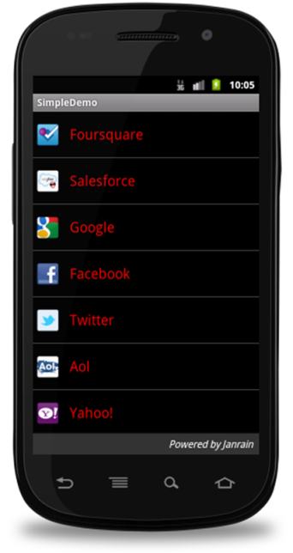
ANDROID –STYLE INHERITANCE
Android supports style Inheritance in very much similar way as cascading style sheet in web design. You can use this to inherit properties from an existing style and then define only the properties that you want to change or add.
To implement a custom theme create or edit My Android App/res/values/themes.xml and add the following −
<resources>
...
<style name="MyCustomTheme" parent="android:style/Theme">
<item name="android:textColorPrimary">#ffff0000</item>
</style> ...
</resources>
In your AndroidManifest.xml apply the theme to the activities you want to style
<activity android:name="com.myapp.MyActivity"
...
android:theme="@style/MyCustomTheme" />
Your new theme will be applied to your activity, and text is now bright red.

Slide 7
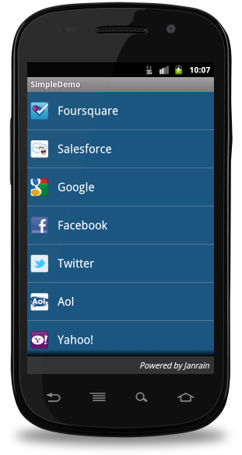
APPLYING COLORS TO THEME ATTRIBUTES
Your color resource can then be applied to some theme attributes, such as the window background and the primary text color, by adding <item> elements to your custom theme. These attributes are defined in your styles.xml file. For example, to apply the custom color to the window background, add the following two <item> elements to your custom theme, defined in My Android App/res/values/styles.xml file
<resources>
...
<style name="MyCustomTheme" ...>
<item name="android:windowBackground">@color/my_custom_color
</item>
<item name="android:colorBackgroundCacheHint">
@color/my_custom_color</item> </style>
...
</resources>

Slide 8


USING A CUSTOM NINE-PATCH WITH BUTTONS
A nine-patch drawable is a special kind of image which can be scaled in width and height while maintaining its visual integrity. Nine-patches are the most common way to specify the appearance of Android buttons, though any drawable type can be used.
A SAMPLE OF NINE-PATCH BUTTON
A SAMPLE OF NINE-PATCH BUTTON
Save this bitmap as /res/drawable/my_nine_patch.9.png
Define a new style
Apply the new button style to the button Style attribute of your custom theme

Slide 9
USING A CUSTOM NINE-PATCH WITH BUTTONS
Define a new Style
<resources> ...
<style name="MyCustomButton" parent="android:Widget.Button">
<item name="android:background">@drawable/my_nine_patch</item>
</style> ...
</resources>
Apply the theme
<resources>
...
<style name="MyCustomTheme" parent=...>
... <item name="android:buttonStyle">@style/MyCustomButton</item>
</style>
...
</resources>

Slide 10
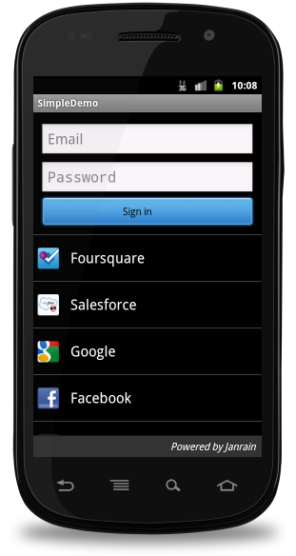
USING A CUSTOM NINE-PATCH WITH BUTTONS
Define a new Style
<resources> ...
<style name="MyCustomButton" parent="android:Widget.Button">
<item name="android:background">@drawable/my_nine_patch</item>
</style> ...
</resources>
Apply the theme
<resources>
...
<style name="MyCustomTheme" parent=...>
... <item name="android:buttonStyle">@style/MyCustomButton</item>
</style>
...
</resources>

Slide 11
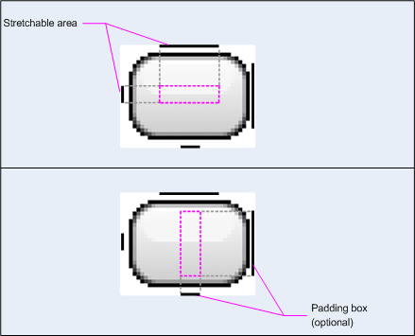

Slide 12
ANDROID THEMES
A theme is nothing but an Android style applied to an entire Activity or application, rather than an individual View.
Thus, when a style is applied as a theme, every View in the Activity or application will apply each style property that it supports.
For example, you can apply the same CustomFontStyle style as a theme for an Activity and then all text inside that Activity will have green monospace font.
To set a theme for all the activities of your application, open the AndroidManifest.xml file and edit the <application> tag to include the android:theme attribute with the style name.
<application android:theme="@style/CustomFontStyle">
But if you want a theme applied to just one Activity in your application, then add the android:theme attribute to the <activity> tag only
<activity android:theme="@style/CustomFontStyle">
inherit them using parent attribute
<style name="CustomTheme"
parent="android:Theme.Light"> ... </style>

Slide 13
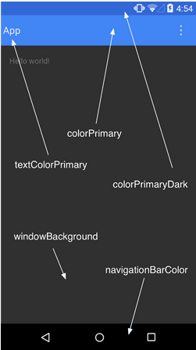
ANDROID -STYLING THE COLOUR PALETTE
The layout design can be implemented based on the base colors, for example as following design is designed based on the colour(blue)
Above layout has designed based on style.xml file, Which is placed at res/values/
<resource>
<style name="AppTheme" parent="android:Theme.Material">
<item name ="android:color/primary">@color/primary</item>
<item name ="android:color/primaryDark"> @color/primary_dark </item>
<item name ="android:colorAccent/primary">@color/accent
</item>
</style>
<resource>

Slide 14
ANDROID -DEFAULT STYLES & THEMES
The Android platform provides a large collection of styles and themes that you can use in your applications. You can find a reference of all available styles in the R.style class. To use the styles listed here, replace all underscores in the style name with a period.
For example, you can apply the Theme_NoTitleBar theme with "@android:style/Theme.NoTitleBar".
You can see the following source code for Android styles and themes −
Android Styles (styles.xml)
Android Themes (themes.xml)

Slide 15
CREATE APP ICONS
Android Studio includes a tool called Image Asset Studio that helps you generate your own app icons from material icons, custom images, and text strings.
At runtime, Android uses the appropriate resource based on the screen density of the device your app is running on.
Image Asset Studio helps you generate the following icon types:
Launcher icons
Action bar and tab icons
Notification icons

Slide 16
LAUNCHER ICONS
A launcher icon is a graphic that represents your app to users. It can:
Appear in the list of apps installed on a device and on the Home screen.
Represent shortcuts into your app (for example, a contact shortcut icon that opens detail information for a contact).
Be used by launcher apps.
Create a first impression of your app.
Help users find your app on Google Play.
Image Asset Studio automatically creates separate icons for the recommended generalized screen densities, including mdpi, hdpi, xhdpi, xxhdpi, and xxxhdpi.

Slide 17
ACTION BAR AND TAB ICONS
Action Bar icons are graphical elements placed in the Action Bar and that represent individual action items.
Tab icons are graphical elements used to represent individual tabs in a multi-tab interface. Each tab icon has two states: unselected and selected
Image Asset Studio automatically creates separate icons for the recommended generalized screen densities, including mdpi, hdpi, xhdpi, and xxhdpi. It places the icons in the proper locations in the res/drawable-density/ directories.

Slide 18
NOTIFICATION ICONS
A notification is a message that you can display to the user outside of the normal UI of your app. When you tell the system to issue a notification, it first appears as an icon in the notification area. To see the details of the notification, the user opens the notification drawer. Both the notification area and the notification drawer are system-controlled areas that the user can view at any time.

